Slide 1
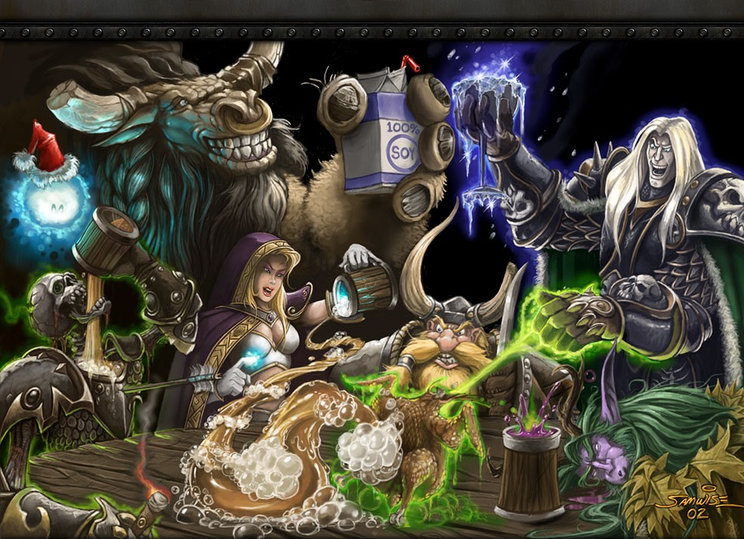
SINGAPORE_SLINGTEAM

Slide 2
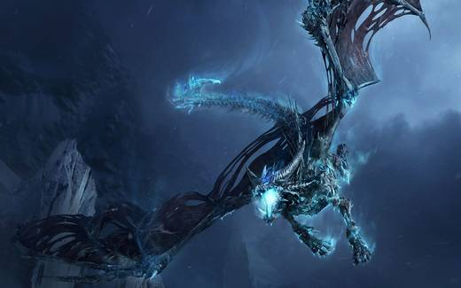

MOTARO WARS

Slide 3
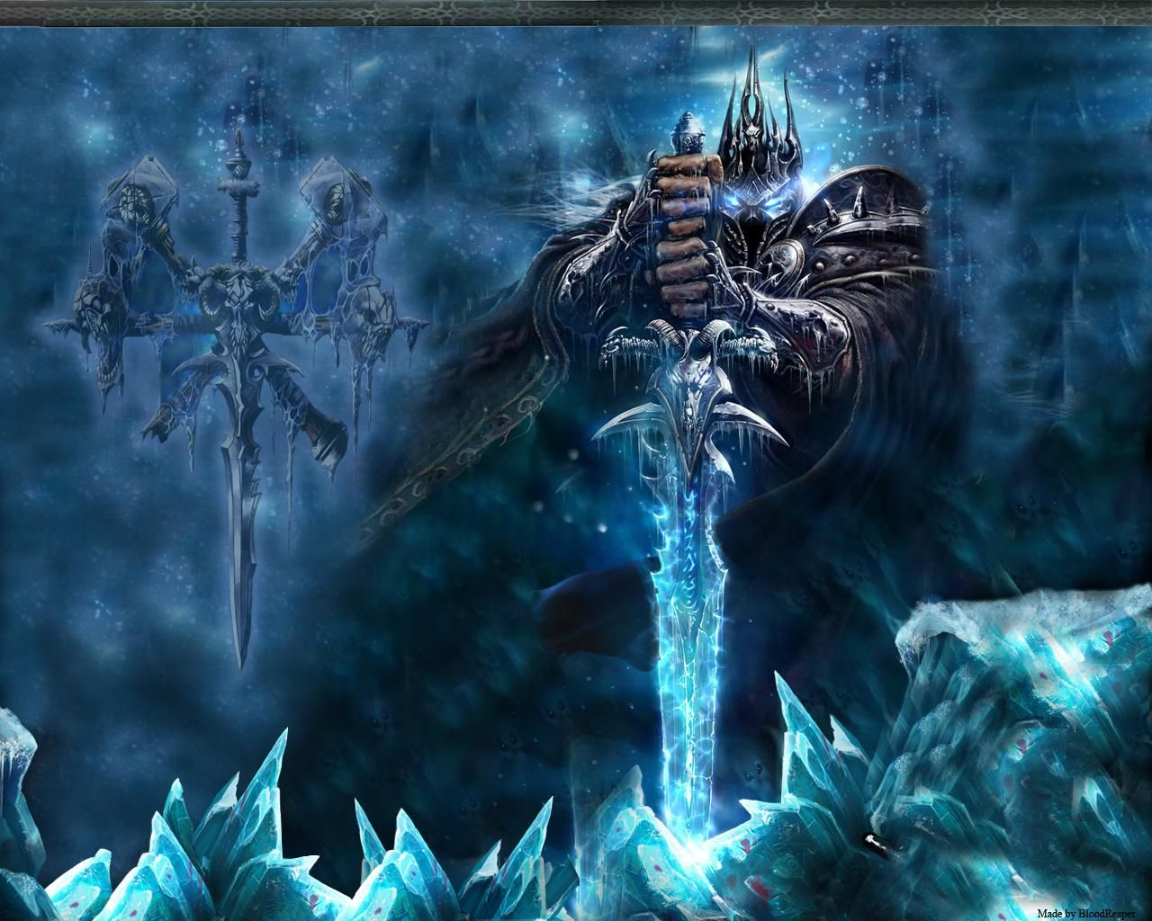
GENRE
Single player Role Playing Game
PLAYERS
The human player controls a HERO of his/her choice. The HERO travels the cursed lands of the game world, brings justice to all kinds of devious creatures and tries to make the world a better place for all mankind.
The enemies our HERO encounters are randomly generated computer driven creatures, they are really nasty and they launch some terrible spells, which fall down on our HERO with one main goal – to destroy him and stop his quest to rid the world of all evil.
POINTS
Each time our HERO destroys an evil creature he earns experience points, learns more and better ways to kill more effectively and therefor become better and stronger.
GAME OVER
Each time our HERO enters a battle he is taking a huge risk of getting hurt and even killed.
If killed the game ends and the player can start from the beginning or load a previously saved game.

Slide 4
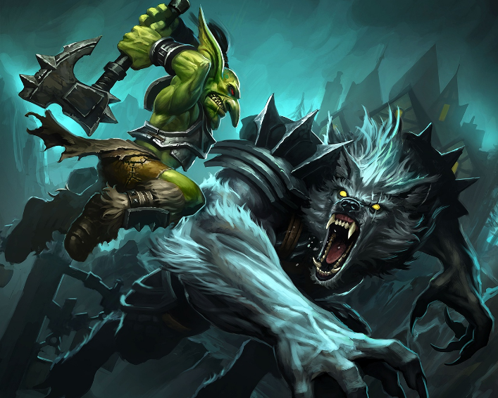
GitHub WebProject URL: https://github.com/micro3x/Heroes_Of_Singapore_Sling
GitHub WebProject URL: https://github.com/micro3x/Heroes_Of_Singapore_Sling

